Slide 1


Slide 2



Case Study: Insurance Analytics
Team Leader Name: Manav Pahilwani
Data Quezt 2023 Team no.:21

Slide 3
Contents
Business understanding
Insights about Data
Exploratory Data Analysis (EDA)
Remedial Measures
Model Building and Deployment
Evaluation of the Model
Inferences
Data Quezt 2023 Team no.:21

Slide 4
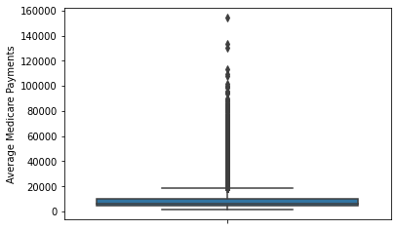
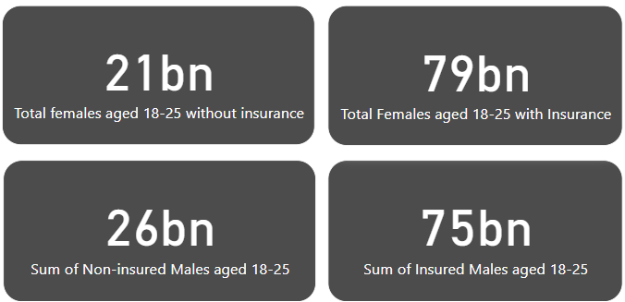
Business Understanding
The dataset contains the data of Insurance(Medicare) provided to individuals in the age group 18-25 of all the states.
Almost ¼ th of the population in the age group has not yet taken Insurance.
The insurance provided varies from state to state where california provides the highest Insurance and Alaska provides the least.
Data Quezt 2023 Team no.:21

Slide 5
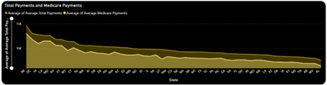
2. Insights about the data
The data has no null values.
Medicare covers almost 80-85% of the medical bills.
California has the most males and female who have availed insurance amongst all the states in the United States while Maryland having the lowest.
In a few cases, only 30-35% of the total bill has been covered in insurance.
Data Quezt 2023 Team no.:21

Slide 6
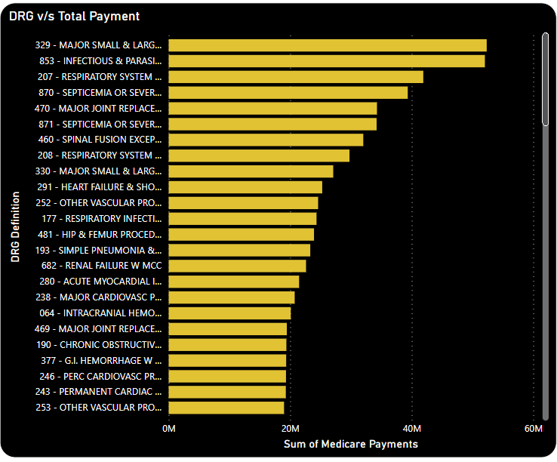
Septicemia or severe sepsis, the Respiratory System and of Infectious diseases make up a disproportionately high share of Medicare costs.
Msmall and large bowel procedures made up the largest total cost to Medicare.
Data Quezt 2023 Team no.:21

Slide 7
3. Exploratory Data Analysis (EDA)
We can observe that the entire data has a few outliers for all the relations, which have a misappropriately higher/better results as compared to other states/DRG codes.
The Medicare to Total payment ratio is almost similar for the entire dataset
The state of Delaware(68) has the highest number of Total Discharges with Wyoming(26) having the lowest.
The Insured to Non Insured ratio for males is almost 3:1 where as 4:1 for females.
Data Quezt 2023 Team no.:21

Slide 8
4. Remedial Measures
Prevention should focus on care of the heart and lunga. Heart procedures account for almost >$25M and respiratory systems almost $42M in Medicare.
Many providers seem to charge more for the same procedure. It would be worthwhile for Medicare to investigate why certain providers bill so far away from the median in different states.
We can assume that bowel related issues can be considered an age constraint and cannot be ignored or reduced.
Data Quezt 2023 Team no.:21

Slide 9
5. Model Building and Deployment
The correlation between Insured males and females with the Total Medicare Payments seems to be quite significant to build a model around.
Columns Insured Males 18-25, Females 18-25 with Insurance, Average Total Payments have been used as input, where as Average Medicare Payments is considered as the output column.
The dataset is split by the ratio 3:7 (test:train).
Using StandardScalar the dataset is scaled( the values are centered around the mean with a unit standard deviation).
Data Quezt 2023 Team no.:21

Slide 10
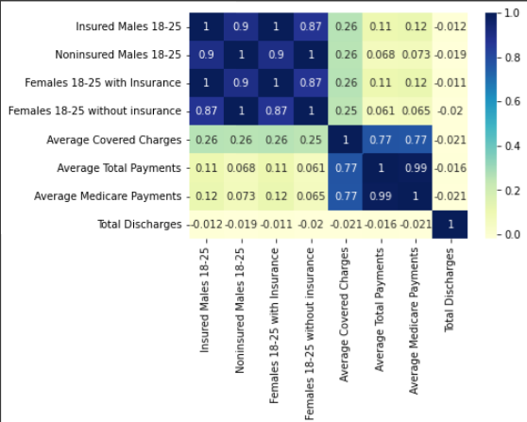
6. Evaluation of the Model
Using Multiple Linear Regression, and Train Test Split a model with the accuracy of almost 97.7% can be achieved which can be further improved using K Fold and Ridge Regularization and increasing upto almost 98.83%.
Data Quezt 2023 Team no.:21

Slide 11
7. Inferences
California has by far and away the most charges and most Insured Males and Females.
The major medicare is allotted to 329 - MAJOR SMALL & LARGE BOWEL PROCEDURES W MCC and 853 - INFECTIOUS & PARASITIC DISEASES W O.R. PROCEDURE W MCC (almost $52M each) with 203 - BRONCHITIS & ASTHMA W/O CC/MCC having the least (almost 2M)
State of Alaska provides highest Medicare Payments ($12K) with the highest Total Payment Average of $15k
Data Quezt 2023 Team no.:21

Slide 12
Q&A
Data Quezt 2023 Team no.:8
Data Quezt 2023 Team no.:21

